Slide 1

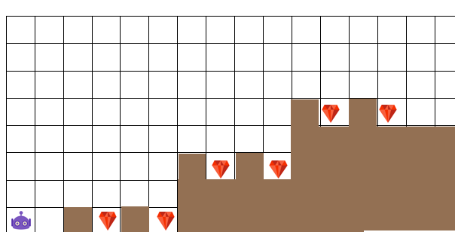
REVIEW
HOMEWORK
CHALLENGE #8
CHALLENGE #9

Slide 2
IF and ELSE
INSTRUCTION

Slide 3


EXPLAIN
Algorithm
5 MIN
The IF instruction has a condition
IF
NO CARROT
GO RIGHT
GO UP

Slide 4
EXPLAIN
Algorithm
5 MIN
The IF instruction contains actions
IF
NO CARROT
GO RIGHT
GO UP

Slide 5

EXPLAIN
5 MIN
We check
If we enter or not into
The IF actions
IF
CARROT
EAT CARROT
If a carrot on the cell
We execute the IF actions
GO RIGHT
And we go to the next step

Slide 6
EXPLAIN
5 MIN
We check
If we enter or not into
The IF actions
IF
CARROT
If NO carrot on the cell
We do not enter the IF bloc
EAT CARROT
And we go to the next step
GO RIGHT

Slide 7
EXPLAIN
Algorithm
5 MIN
The ELSE instruction contains actions
It happens if the condition from the IF is false
IF
CARROT
EAT CARROT
ELSE
GO UP

Slide 8


What is the difference btw those 2 programs
GO FORWARD
IF <HAS CARROT>
EAT
PAINT CELL
GO FORWARD
IF <HAS CARROT>
EAT
ELSE
PAINT CELL

Slide 9
1 we check if we go to :
The IF ACTIONS
Or the ELSE ACTION
IF
CARROT
2 If condition is FALSE
We go to the ELSE
GO RIGHT
ELSE
GO LEFT
3 And then we exit the IF/ELSE

Slide 10



EXPLAIN
IF
CARROT
IF
RED
5 MIN
EAT CARROT
What happens here ?
ELSE
GO FORWARD
IF
BANANA
EAT BANANA

Slide 11
EXPLAIN
IF
CARROT
IF
RED
5 MIN
EAT CARROT
What happens here ?
ELSE
GO FORWARD
IF
BANANA
EAT BANANA

Slide 12
EXPLAIN
IF
CARROT
IF
RED
5 MIN
EAT CARROT
What happens here ?
ELSE
GO FORWARD
IF
BANANA
EAT BANANA

Slide 13

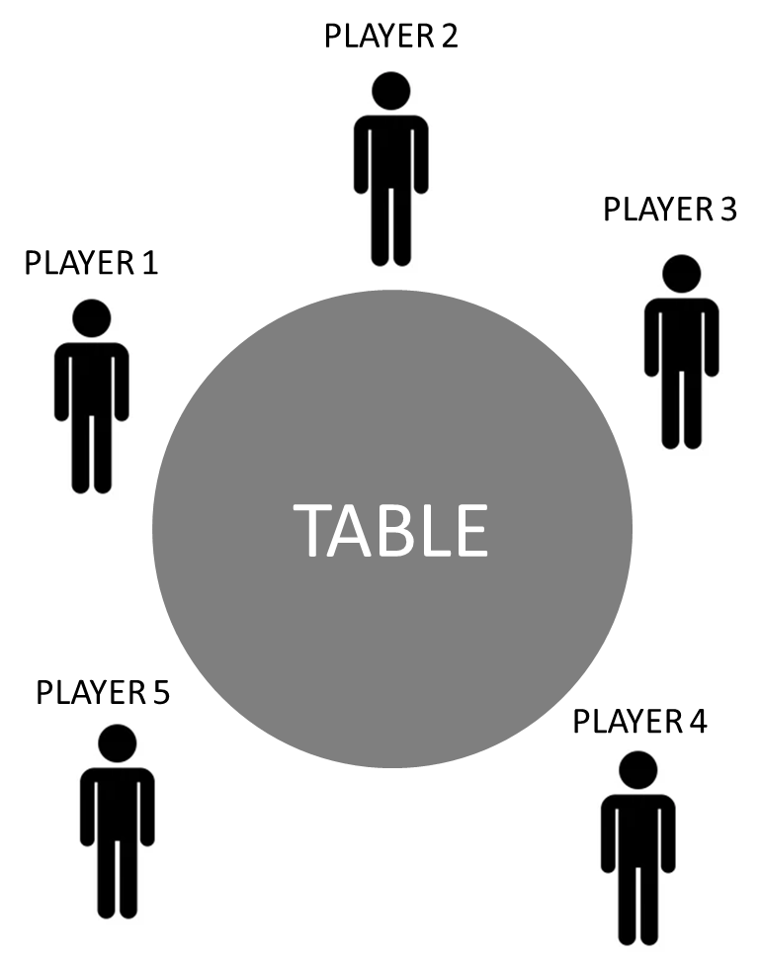

GAME
CHALLENGE 1 : DEMO
Preparation :
Player 1 has 1 diamond
Player 2 has 1 diamond
Player 3 has 2 diamonds
Player 4 has Jack
Player 5 has nothing
15 MIN
Team of 5
IF
Player 2 has
Who has JACK ?
IF
Player 3 has
-> Player 2
ELSE
-> Player 5
ELSE
-> Player 4
 | Challenge 1 | Challenge 2 | Challenge 3 – Version 1 | Challenge 3 – Version 2
Who has Jack ?
Notes:
Answer : challenge 1 : Player 5 challenge 2 : Player 3
Challenge 3 : version 1 : player 1
version 2 : player 3

Slide 14
We can express conditions with a tree
IF <HAS CARROT>
EAT
HAS CARROT ?
YES
NO
ELSE
PAINT CELL
EAT
PAINT CELL

Slide 15

Conditions can be nested
IF <HAS CARROT>
HAS CARROT ?
IF <GOOD CARROT>
YES
NO
EAT
ELSE
GOOD CARROT ?
PAINT CELL
PICK UP
YES
NO
ELSE
PAINT CELL
EAT
PICK UP

Slide 16
PRACTICE
Transfom this algorithm into a flowchart
5 MIN
INDIV
IF
CARROT
HAS CARROT
IF
RED
FALSE
TRUE
EAT CARROT
ELSE
GO RIGHT
ELSE
IF
BANANA
ELSE
EAT BANANA
ELSE
DON’T MOVE

Slide 17
PRACTICE
Transfom this flowchart in an algorithm
5 MIN
INDIV
IF
Skirt
TRUE
Sunny
TRUE
Jeans
FALSE
Girl
Short
FALSE
Sunny
TRUE
FALSE
Jeans

Slide 18
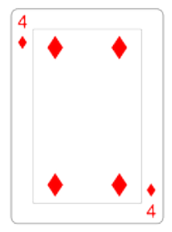
QUIZ
SCORE = 05
2 MIN
CLASS
IF
CARD > 5
IF
CARD is RED
SCORE = 10
ELSE
SCORE = 20
Q1: SCORE = ?

Slide 19
QUIZ
SCORE = 05
2 MIN
CLASS
IF
CARD > 5
IF
CARD is RED
SCORE = 10
ELSE
SCORE = 20
Q1: SCORE = 05

Slide 20
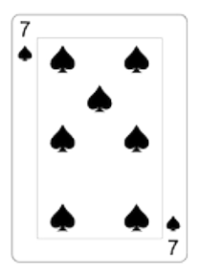
QUIZ
SCORE = 05
2 MIN
CLASS
IF
CARD > 5
IF
CARD is RED
SCORE = 10
ELSE
SCORE = 20
Q2: SCORE = ?

Slide 21
QUIZ
SCORE = 05
2 MIN
CLASS
IF
CARD > 5
IF
CARD is RED
SCORE = 10
ELSE
SCORE = 20
Q2: SCORE = 20

Slide 22
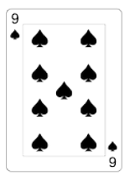
QUIZ
SCORE = 05
2 MIN
CLASS
IF
CARD > 8
SCORE = 10
IF
CARD is BLACK
SCORE = 20
Q3: SCORE = ?

Slide 23
QUIZ
SCORE = 05
2 MIN
CLASS
IF
CARD > 8
SCORE = 10
IF
CARD is BLACK
SCORE = 20
Q3: SCORE = 20

Slide 24
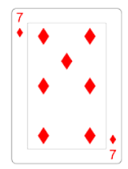
QUIZ
SCORE = 05
2 MIN
CLASS
IF
CARD HAS DIAMOND
SCORE = 10
ELSE
IF
CARD < 4
SCORE = SCORE + 20
ELSE
SCORE = SCORE + 30
IF
Q4: SCORE = ?

Slide 25
QUIZ
SCORE = 05
2 MIN
CLASS
IF
CARD HAS DIAMOND
SCORE = 10
ELSE
IF
CARD < 4
SCORE = SCORE + 20
ELSE
SCORE = SCORE + 30
IF
Q4: SCORE = 10

Slide 26
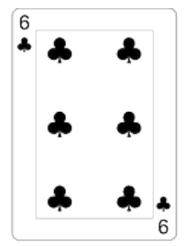

QUIZ
SCORE = 05
2 MIN
CLASS
IF
CARD HAS
SCORE = 10
ELSE
SCORE = 20
IF
CARD > 4
SCORE = SCORE + 50
Q5: SCORE = ?

Slide 27
QUIZ
SCORE = 05
2 MIN
CLASS
IF
CARD HAS
SCORE = 10
ELSE
SCORE = 20
IF
CARD > 4
SCORE = SCORE + 50
Q5: SCORE = 60

Slide 28

PRACTICE
CHALLENGE
MAX BLOC
BLOCS
#1
10
REPEAT <N times>
5 MIN
INDIV
IF< CONDITION>
GO RIGHT
HAS DIAMOND
PICK UP
< ENTER CODE >
CASE 1
CASE 2
CASE 3
TAKE ALL DIAMONDS

Slide 29

PRACTICE
CHALLENGE
MAX BLOC
BLOCS
#2
10
IF < CONDITION>
GO RIGHT
5 MIN
INDIV
PICK UP
REAPEAT <N times>
EAT
HAS CAKE
HAS DIAMOND
< ENTER CODE >
CASE 1
CASE 2
TAKE ALL DIAMOND
EAT ALL CAKES
CASE 3

Slide 30


HOMEWORK
INDIV
After class
1. Review this lesson.
2. Finish all challenges on toxicode :
http://compute-it.toxicode.fr/
3. Submit your work to Google Classroom

